Slide 1
4. Statistical Distributions
Willamette University
CS-429
Spring 2018

Slide 2
Statistics and Data Science
“A data scientist is someone who knows more statistics than a computer scientist and more computer science than a statistician.”
--Josh Blumenstock

Slide 3
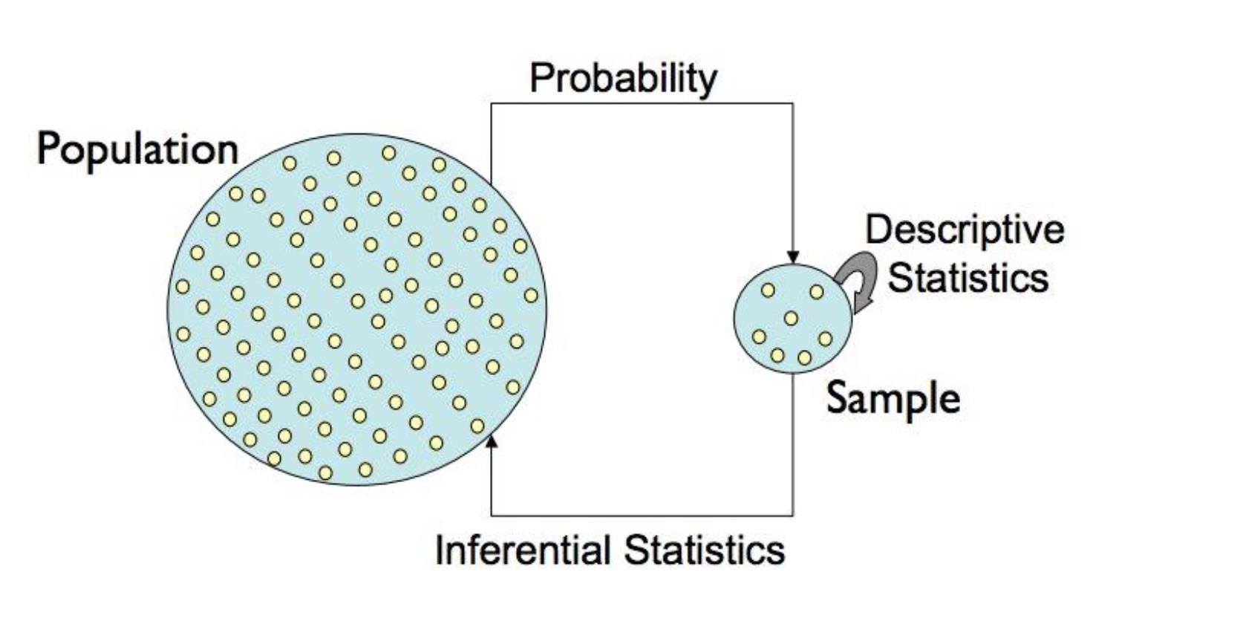
Statistics

Slide 4
Statistical Data Distributions
Every Observed random variable has a particular frequency/probability distribution
Frequently occurred distributions:
The Binomial distribution
The Normal distribution
The Poisson distribution
The Power Law distribution

Slide 5
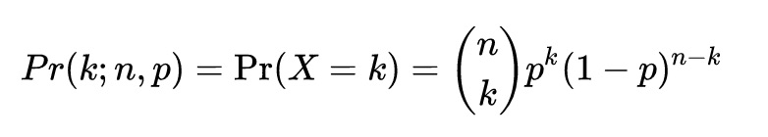
Binomial Distribution
Experiments consist of n identical, independent trials which have two possible outcomes, with probabilities p and (1-p), like heads or tails.
Probability mass function:

Slide 6
Example
A biased coin comes up heads with probability 0.3 when tossed. What is the probability of achieving 0, 1, ...6 heads after six tosses?
Pr(k; n, p) = ?

Slide 7
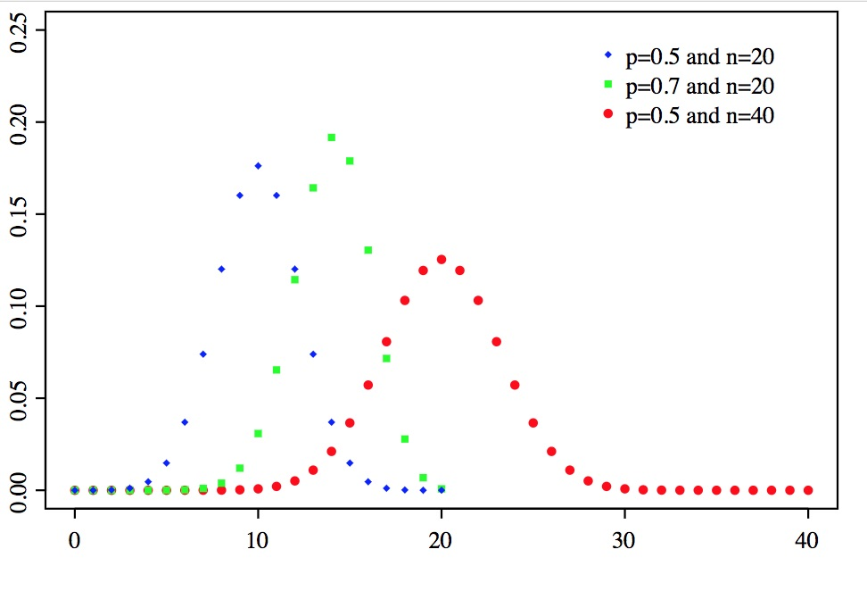
Probability Mass Function for Binomial Distribution
https://en.wikipedia.org/wiki/Binomial_distribution

Slide 8
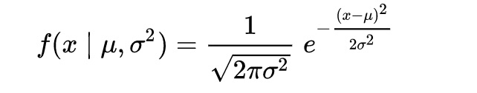
Normal Distribution
Bell shaped distribution of height, IQ, etc.
Completely parameterized by mean and standard deviation:
Generalization of the binomial distribution
https://en.wikipedia.org/wiki/Normal_distribution

Slide 9
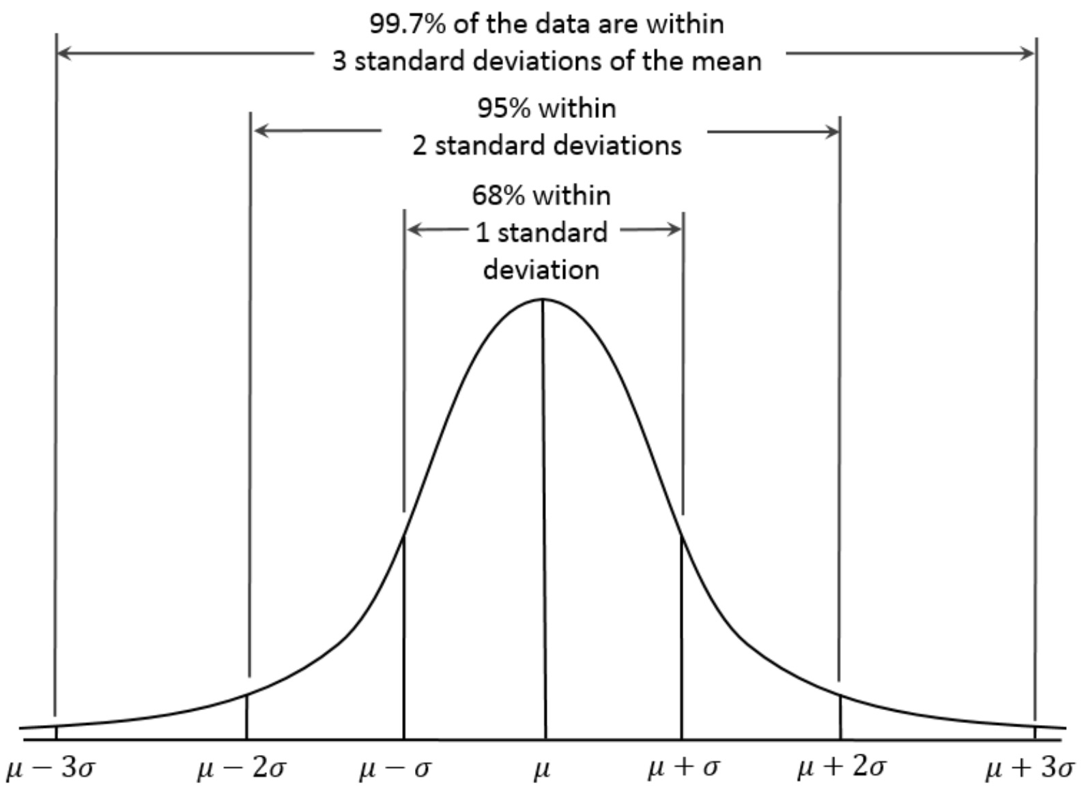
Normal Distribution

Slide 10
Interpreting Normal Distribution
IQ is normally distributed, with mean 100 and standard deviation 15
About 2.5 % of people have IQs above 130.

Slide 11
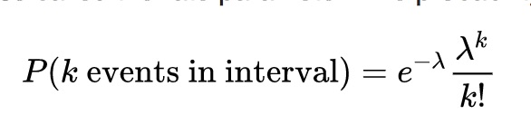
Poisson Distribution
Measures the frequency of intervals between rare events.
https://en.wikipedia.org/wiki/Poisson_distribution

Slide 12
Power Law Distribution
One quantity varies as a power of another: p(x) = c^{-a} for exponent a and normalization constant c.
They do not cluster around a mean like a normal distribution, instead having very large values rarely but consistently
They define 80-20 rules: 20% of the X get 80% of the Y
https://en.wikipedia.org/wiki/Power_law

Slide 13
City population
The average big US city has population 165,719.
Even with a huge standard deviation of 410, 730, the biggest city under a normal distribution should be Indianapolis (780K).
New York city has 8,008,278 people in the 2000 census (the rich get richer)
https://en.wikipedia.org/wiki/Power_law

Slide 14
Log-log plot
Straight line on log-log plots → power law
The biggest values are out of scale on linear plot
List events that follow the power law

Slide 15
Properties of Power Laws
The mean does not make sense.
The standard deviation does not make sense
The median better captures the bulk of the distribution
The distribution is scale invariant: meaning zoomed in regions look like the whole plot

